Slide 1
Learning Objective
I will be able to review probability and relative frequencies
Success Criteria
At the end of the lesson, I will be able to:
3.3.1 Develop the concepts of a discrete random variable and its associated probability function, and their use in modelling data
3.3.2 Use relative frequencies obtained from data to obtain point estimates of probabilities associated with a discrete random variable

Slide 2
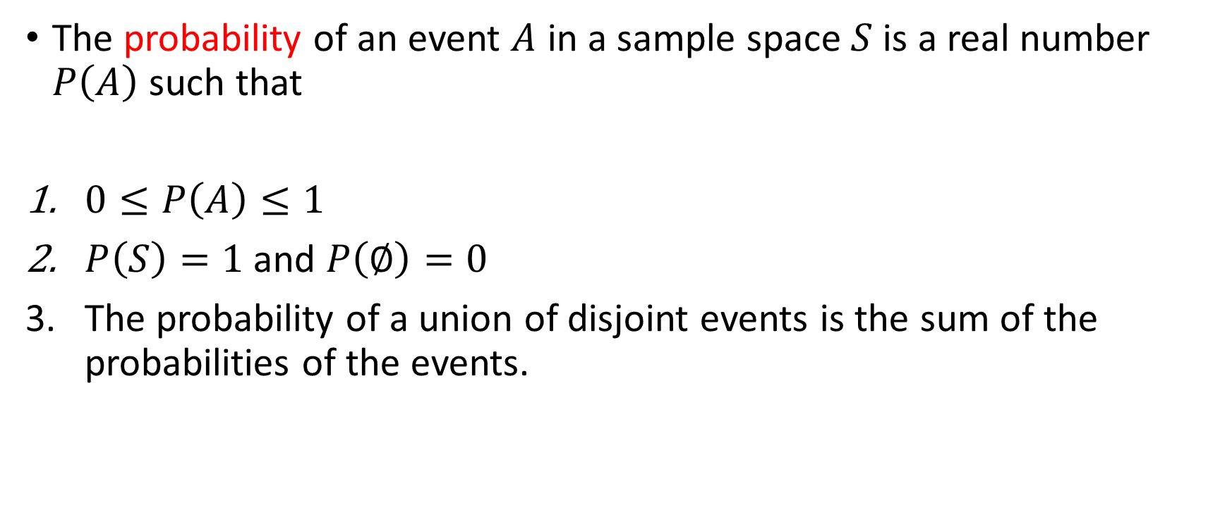
Probability
Activating Prior Knowledge
The probability of an event $A$ in a sample space $S$ is a real number $P\left(A\right)$ such that
$0≤P\left(A\right)≤1$
$P\left(S\right)=1$ and $P\left(∅\right)=0$
The probability of a union of disjoint events is the sum of the probabilities of the events.

Slide 3
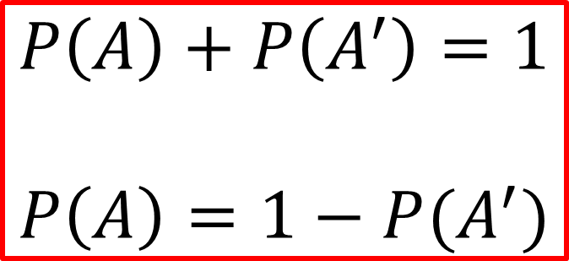

Complementary Events
Activating Prior Knowledge
The complement of event $A$ is event $A′$.
The sum of the probability of event A and its complement $A′$ is 1
$$P\left(A\right)+P\left(A^{′}\right)=1$$
$$P\left(A\right)=1−P(A^{′})$$

Slide 4
Relative Frequency
Activating Prior Knowledge
This is also known as experimental probability.
For example tossing a coin:
Theoretical probability of obtaining a head is 50%.
If we toss a coin for 100 times, we may have 58 times of head and hence the relative frequency (experimental probability) is 58%.
If we toss a coin for 1000 times, we may have 540 times of head and hence the relative frequency (experimental probability) is 54%.
If we toss a coin for 10 000 times, we may have 5 200 times of head and hence the relative frequency (experimental probability) is 52%

Slide 5
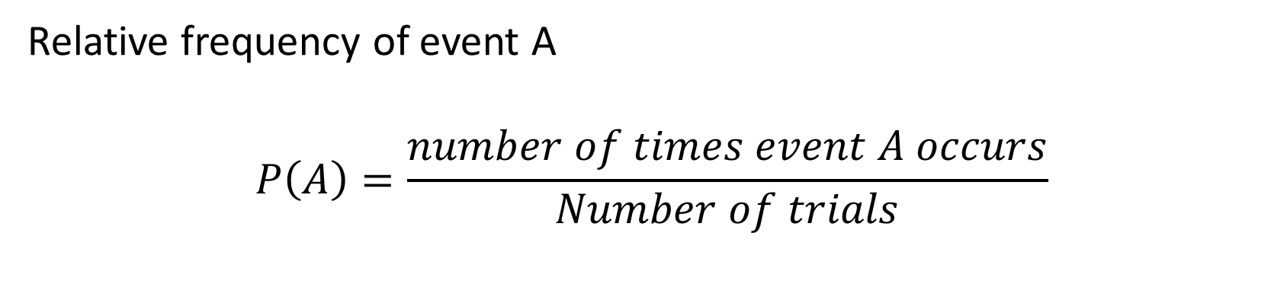
Calculating relative frequency
Activating Prior Knowledge
Relative frequency of event A
$$P\left(A\right)=\frac{number of times event A occurs}{Number of trials}$$

Slide 6
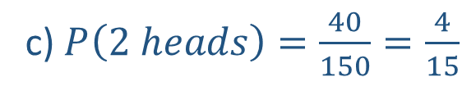
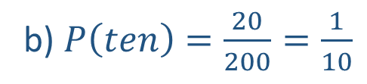
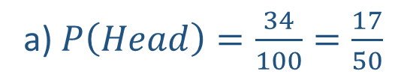
Activating Prior Knowledge
Estimate the probability of the event specified occurring, using the data given:
Pr(Head) if a coin is tossed 100 times and 34 heads observed
Pr(ten) if a spinner is spun 200 times and lands on the ‘ten’ 20 times
Pr (two heads) if two coins are tossed 150 times and two heads are observed on 40 occasions.
a) $P\left(Head\right)=\frac{34}{100}=\frac{17}{50}$
b) $P\left(ten\right)=\frac{20}{200}=\frac{1}{10}$
c) $P\left(2 heads\right)=\frac{40}{150}=\frac{4}{15}$

Slide 7











Guided Practice
Activating Prior Knowledge
What are the possible outcomes when a fair coin is toss twice?
$$H$$
$$HH$$
$$H$$
$$T$$
$$HT$$
$$H$$
$$TH$$
$$T$$
$$T$$
$$TT$$
Sample space: $\{HH,HT,TH, TT\}$

Slide 8
Mutually exclusive events
Activating Prior Knowledge
These events cannot occur at the same time.
Example
tossing a coin
cannot have both head and tail at the same time
rolling a die
rolling an even and odd number cannot happen at the same time
rolling an even and prime number can happen at the same time
coming to school
being driven to school in a car cannot happen at the same time as riding a bicycle

Slide 9
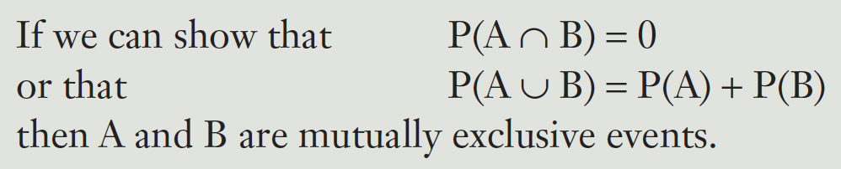
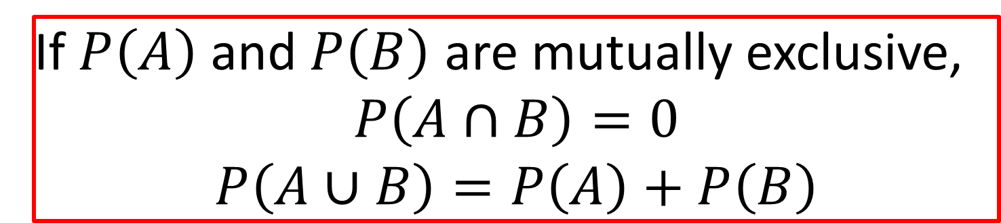
Addition rule
Activating Prior Knowledge
$$P\left(A∪B\right)=P\left(A\right)+P\left(B\right)−P(A∩B)$$
If $P\left(A\right)$ and $P\left(B\right)$ are mutually exclusive,
$$P\left(A∩B\right)=0$$
$$P\left(A∪B\right)=P\left(A\right)+P\left(B\right)$$

Slide 10
Activating Prior Knowledge
A summary of probability table:
 | Event B | Event B’
Event A
Event A’

Slide 11





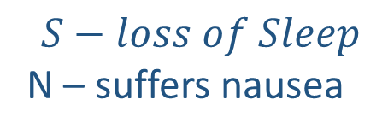




Guided Practice
A new drug has been released and produces some minor side effects:
8% of users suffer only loss of sleep, 12% of users suffer only nausea, and
75% of users have no side effects at all.
What percentage of users suffer from both loss of sleep and nausea?
$$S−loss of Sleep$$
N – suffers nausea
$$N$$
$$N′$$
$$S$$
$$0.05$$
$$0.08$$
$$S′$$
$$0.12$$
$$0.75$$
$$P\left(S∩N\right)=1−0.08−0.12−0.75$$
$$=0.05=5\&$$

Slide 12








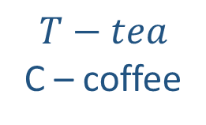






Guided Practice
In a particular country it has been established that the probability that a person drinks tea is 0.45, the probability that a person drinks coffee is 0.65, and the probability that a person drinks neither tea nor coffee is 0.22. Use the information to complete a probability table and hence determine the probability that a randomly selected person in that country:
Drinks tea but not coffee
Drinks tea and coffee
$$0.13$$
$$0.32$$
$$T−tea$$
C – coffee
$$T$$
$$T′$$
$$C$$
$$0.32$$
$$0.33$$
$$0.65$$
$$C′$$
$$0.13$$
$$0.22$$
$$0.35$$
$$0.45$$
$$0.55$$

Slide 13
Independent Practice
Complete Cambridge Ex 8A

